Slide 1
Superstore sale prediction
Using scikit-learn

Slide 2
Exploratory Data Analysis

Slide 3
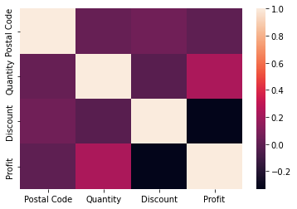
Multicollinearity

Slide 4
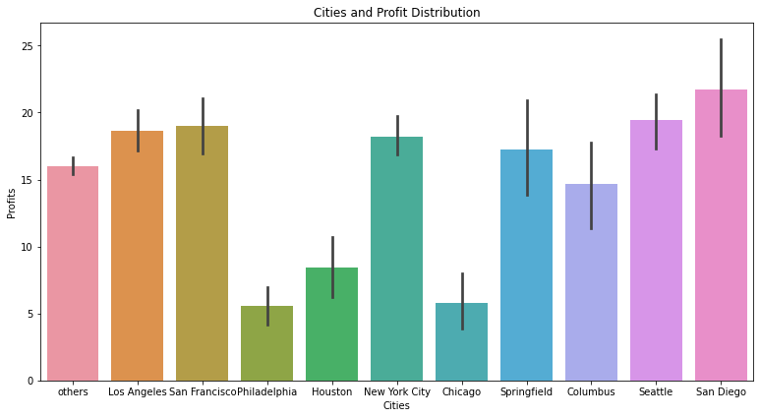
Profit Distribution of Cities

Slide 5
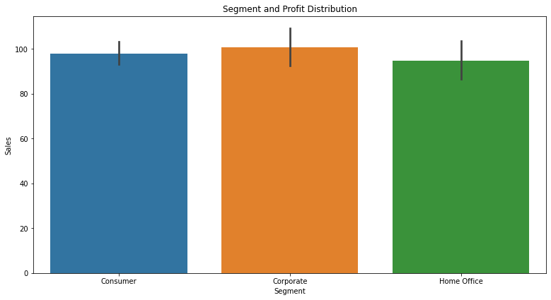
Sales distribution of Segment

Slide 6
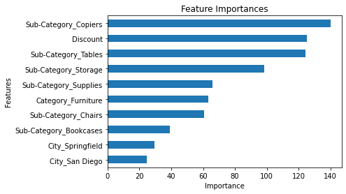
Modeling and prediction

